Slide 1

“Date-a-Scientist” Capstone Project
Machine Learning Fundamentals Created by Sarah Stepak.
April 8th, 2019.

Slide 2
Table of Contents
Question 1: Is it possible to determine age based on health factors? …. Slides # 3-24 | Question 2: Is it possible to determine gender based on star sign and body type? …. Slides #28-44.
How I arrived at my question…. Slide #5. Exploration of the Dataset…. Slides #6-8. Augmenting the Dataset…. Slides #9-12. Regression Approaches…. Slides #13-16. Data Visualizations…. Slides #17-27. Conclusions/Next steps…. Slide #27. | How I arrived at my question…. Slide #30. Exploration of the Dataset…. Slide #31. Augmenting the Dataset…. Slides #32-33. Classification Approaches…. Slides #34-37. Data Visualizations…. Slides # 38-41. Conclusions/Next steps…. Slide # 42.
Overall Conclusion…. Slides #43-45.

Slide 3
Question 1
Can you predict age on health?

Slide 4
Is it possible to determine age based on physical and/or mental factors?

Slide 5
How I Came Up With This Question
When I first started the capstone project, I was greeted with many columns of data. The first few I noticed however, were all the ones related to a users overall health. Shortly after, I had received a message stating that I had rugby practice later that day. This led me to think about some of the players on my team who are very healthy, and how much older they were compared to me. I quickly than began to look at all the value counts to df.body_type, because I wanted to see if there was a correlation between health and age; the rest is history.

Slide 6
Exploring the Dataset
I determined that overall user health would be classified under two health factors: physical and mental.
Firstly, physical health factors included topics under: body type, diet, drug history, height, as well as their smoking history.
Mental health factors would include: The users education, the users income level, the user’s profession, if the user has or wants pets, as well as if the user wanted children.

Slide 7
Exploring Continued
In order to use the data within the data set, I had to create ten new columns. Each column would give a score based on overall health; the higher the score, the better the health. The following formula shows how I calculated this. Note: An items health rank was determined over how healthy it was compared to the set.
Health Ranking
Overall Health = ------------------- Total Items in the Set

Slide 8
Exploring Continued
Overall, there were eleven new data tables created in order to store the new numeric values of the set. The twelfth column was created to normalize the data.
The following slides will show you two of the eleven numeric data tables, their associated values, as well as give an explanation.

Slide 9
The drinks_data Column
drinks | drinks_data
"desperately" | 0.1666
"very often" | 0.3333
"often" | 0.5
"socially" | 0.6666
"rarely" | 0.8333
"not at all" | 1
The way I created this column was by declaring a new column in df called “drinks_data.” I then mapped all the values of drinks to a numerical value, each based on the overall health as the “drinks_data” column values.
Drinking is very bad for you, so the highest score (1) a user could get would be if they do not drink. On the other hand, if a user inputted “desperately” as a response, they would get the lowest score possible. These scores are stored in an array called drink_mapping. For each of these inputs, there is a score associated with that value, based on the overall health formula. The following slide has the code I used to map and create the drinks_data column.

Slide 10
drinks_data code
df = pd.read_csv("profiles.csv")
drink_mapping = {"desperately":0.1666,
"very often":0.3333,
"often":0.5,
"socially":0.6666,
"rarely":0.8333,
"not at all":1}
df["drinks_data"] = df.drinks.map(drink_mapping)

Slide 11
The drugs_data Column
The way I created this column was by declaring a new column in df called “drugs_data.” I then mapped all the values of drinks to a numerical value, each based on the overall health as the “drugs_data” column values.
These numeric values are stored in an array called drugs_mapping. The scores are based on the overall health formula. Doing drugs is also very bad for your health, and so If a user does drugs “often,” they would get the lowest score of 0333. However, If a user does not use drugs, they would get a 1. The code for creating this column is located on the next slide.
drugs | drugs_data
"often" | 0.3333
"sometimes" | 0.6666
"never" | 1

Slide 12
drugs_data code
df = pd.read_csv("profiles.csv")
drugs_mapping = {"often":0.3333,
"sometimes":0.6666,
"never":1}
df["drugs_data"] = df.drinks.map(drugs_mapping)

Slide 13
Choosing a Machine Learning Algorithm.

Slide 14
Regression
The machine learning algorithm I chose for this problem was regression. I chose not to use classification because I was predicting a number, not a category.

Slide 15
Comparing Regression Techniques
Multiple-Linear Simplicity
Ridge Simplicity
This technique only requires you to pass two arguments when imported from sklearn; as the mathematical function is rather simple. However, you must then chose a way to fit the data; min-max or z-score. Each carry a set of their own issues, which may come up depending on the type of data you are analyzing.
This technique requires quite a few arguments. The mathematical function is rather complex, as it comes with error handling. However, this technique has the ability to normalizes the data, in order to have the best possible fit.

Slide 16
Comparing Regression Techniques Continued
Multiple-Linear
Ridge
Run-Time | 7.253 s
Accuracy (overall health) | 3.1522 %
Precision | 3.3017 %
Run-Time | 8.176 s
Accuracy (overall health) | 10.5037 %
Precision | 9.6420 %

Slide 17
Visualizing Predictions Using a Ridge Regression Model

Slide 18
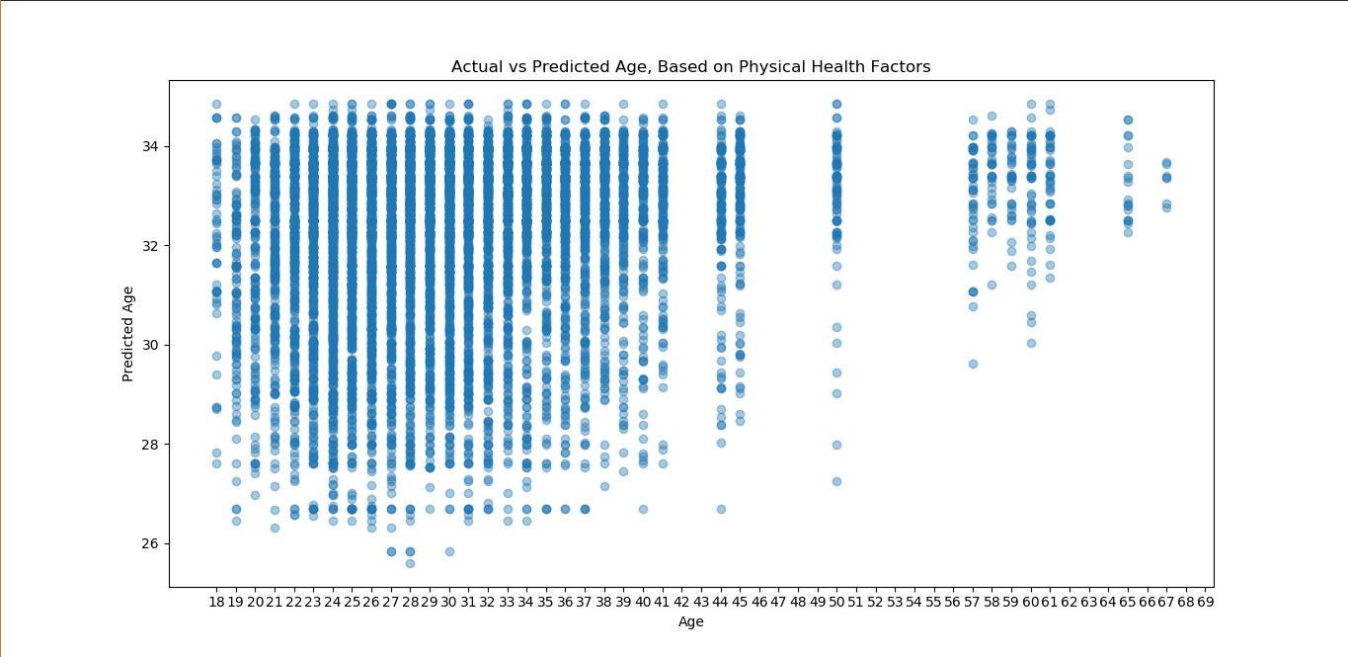
Age Predicted Using Physical Health
Key Points
Accuracy | 3.3017 %
Precision | 3.1521 %
Run-Time | 7.605 s

Slide 19
Age Predicted Using Physical Health
The model currently in discussion shows to bunch up between the ages 32 and 34, and steadily declines all the way to the approximate age of 28. This seems to happen at the ages between 41 and 18. This model is about 3% more accurate. This image has also been scaled on the following slide for your better viewing.

Slide 20
Figure 1: Age Predicted By Physical Health Factors, Scaled.

Slide 21
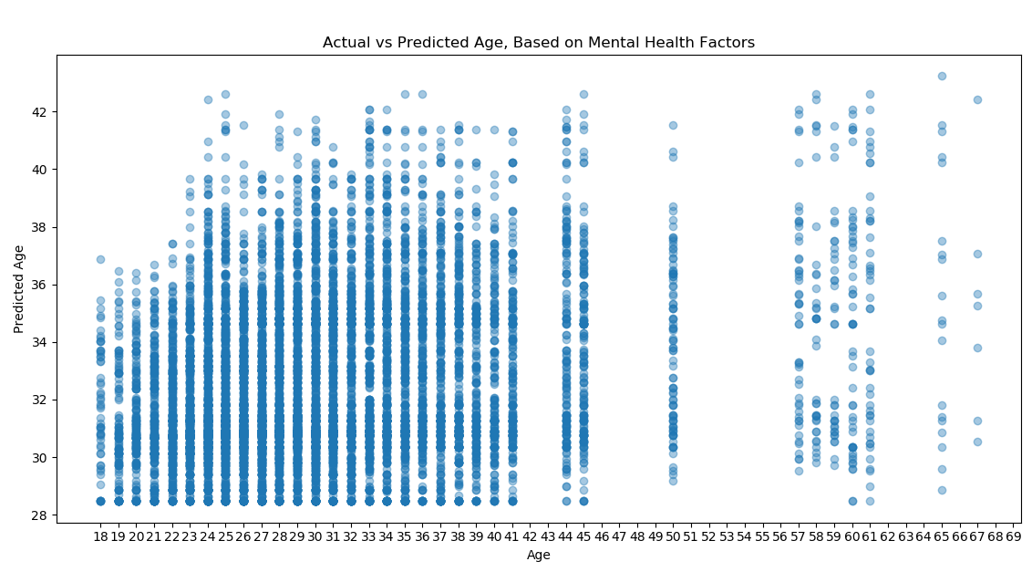
Age Predicted Using Mental Health
Key Points
Accuracy | 8.6707 %
Precision | 7.8410 %
Run-Time | 8.29 s

Slide 22
Age Predicted Using Mental Health
The model currently in discussion shows to incline from between the ages 18 to 41, starting at the age of 29 all the way up to the age 39. This model is about 5% more accurate than the previous model, and shows to have a better precision as well. This image is scaled on the following slide for your better viewing.

Slide 23
Figure 2: Age Predicted by Mental Health Factors. Scaled.

Slide 24
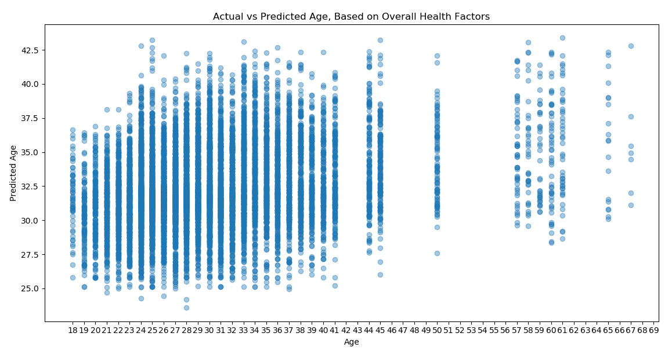
Age Predicted Using Overall Health
Key Points
Accuracy | 10.5037 %
Precision | 9.6420 %
Run-Time | 8.176 s

Slide 25
Age Predicted Using Overall Health
The model uses all the mapped data created in order to classify age. It appears to have a path of a square root function. This model is about 10% accurate in total, with a 9% precision as well. I would not classify this model, or its children models as a source of accuracy. This image is scaled on the following slide for your better viewing.

Slide 26
Figure 3: Age Predicted By Overall Health Factors. Scaled.

Slide 27
In conclusion to #1,
When asking the question, “Is it possible to predict age based on health?” The answer is no, due to a low 10% accuracy, partly due to the dataset I currently have. Age is a topic which involves a numerous amount of factors, and I only used eleven. My next steps would be to research more regression methods to see which would fit the model even better, or to take a step back at how I’m classifying health. If I were to have more data, I would like to have more data regarding health such as: If the user plays sports, if the user has any injuries, how many friends the user has, if the user is disabled, if the user is introverted or extroverted, etc.

Slide 28
Question 2
Can you predict gender?

Slide 29
Is it possible to predict gender, based on the person’s sign and their body type?

Slide 30
How I Came Up With This Question
I was looking at a summer internship on this company's website where they predicted the most random things using astrology. (ie: Plug in your star sign and we’ll tell you if you are going to have this medical issue.) I decided to be a little more civil, and I simply wanted to know if it was possible to predict gender using astrology. There were too few independent variables for my liking, and so I added body type.

Slide 31
Exploring the Dataset
Due to the fact that I had created this question after I completed my first, I did not explore all that much with the data. I pulled in my values from body_type_data, and simply called df.sign.value_count(). Value_count() would get me all the possible values a user could input for their star sign. I used this method as well for the users gender. The following slides will show you how I mapped the users gender data into a useable value.

Slide 32
The gender_data Column
The way I created this column was by declaring a new column in df called “gender_data.” I had decided to map all the values to m and f to be 0 and 1, If the user identified as “male” they would have a 0 mapped to their location in the column. If the user identified as “female” they would then have a 1 mapped. I did this so I wouldn’t have to worry about collecting these values later when I plotted my graph. The following slide shows the code used for this event.
sex | gender_data
m | 0
f | 1

Slide 33
gender_data code
df = pd.read_csv("profiles.csv")
sex_mapping = {"m":0, "f":1}
df["gender_data"] = df.sex.map(sex_mapping)

Slide 34
Choosing a Machine Learning Algorithm.

Slide 35
Classification
The machine learning algorithm I chose for this problem was classification. I chose not to use regression because I was predicting a category, not a large ranged specific number.

Slide 36
Comparing Classification Techniques
K-Neighbors Simplicity
Support Vector Simplicity
K-Neighbors proved to be the simpler method between the two, due to it’s quick run time and the fact that the developer would only have to worry about one argument, rather than multiple.
The support vector classification is not a good choice for this data. It takes nearly 10 times the amount of time K-Neighbors needs to run. While it was nice that it easily declared a vector for the difference between the two sets, It had a lot of variables a developer would have to look out for when they implemented it. Ie, the type of kernel used, and the data behind it.

Slide 37
Comparing Classification Techniques Continued
K-Neighbors
Support Vector
Run-Time | 8.864 s
Accuracy | 66.05 %
F1 - Score | 47.30 %
Precision | 63.98 %
Recall | 37.52 %
Run-Time | 83.339 s
Accuracy | 63.85 %
F1 - Score | 46.80 %
Precision | 58.16 %
Recall | 39.15 %

Slide 38
Visualizing Predictions Using a K-Neighbors Classification Model

Slide 39
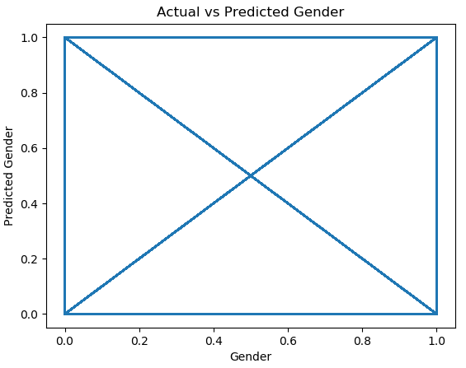
Gender Predicted Using Star Sign and Body Type
Key Points
Run-Time | 8.864 s
Accuracy | 66.05 %
Precision | 63.98 %

Slide 40
Gender Predicted Using Star Sign and Body Type
The model uses all the mapped data created in order to classify gender. It appears to have a rather unique path. This model is about 66% accurate in total, with a 63% precision as well. I would classify this model as a source of accuracy. This image is scaled on the following slide for your better viewing.

Slide 41
Figure 4: Actual vs Predicted Gender scaled

Slide 42
In conclusion to #2,
an overall conclusion, with a preliminary answer to your initial question(s), When asked “Is it possible to predict a users gender based on star sign and body type?” I would say that yes it is possible. The model here has a better accuracy than a coin toss, at a whopping 66%. My next steps would be to see if there was a better independent variable, alongside with the users star sign, in order to improve accuracy. If I had more data to better answer my question, I would like more data based on the users gender. There are users in the world who do not identify as “male” or “female,” and as a result of that, I would love to see where that data would take me.

Slide 43
Final Thoughts
An overall conclusion.

Slide 44
An overall conclusion.
Overall, it is possible to answer question 2 with the current data that I have. However, for problem 1, I would say otherwise. Age can be affected by a numerous amount of health factors, and the data here is only a fraction. My next steps would be finding better independent variables for a better accuracy, or to go back and look at the logic behind question 1. If I were to have more data, I would love to have data regarding health and/or gender.

Slide 45
Fini.

